Slide 1




The EagleSat 2: Fabrication Team Finalizations
Lillian Sudkamp - Fabrications Integrator
Embry-Riddle Aeronautical University Prescott
Mentor: Dr. Ahmed Sulyman
Arizona Space Grant Symposium
April 23, 2022

Slide 2
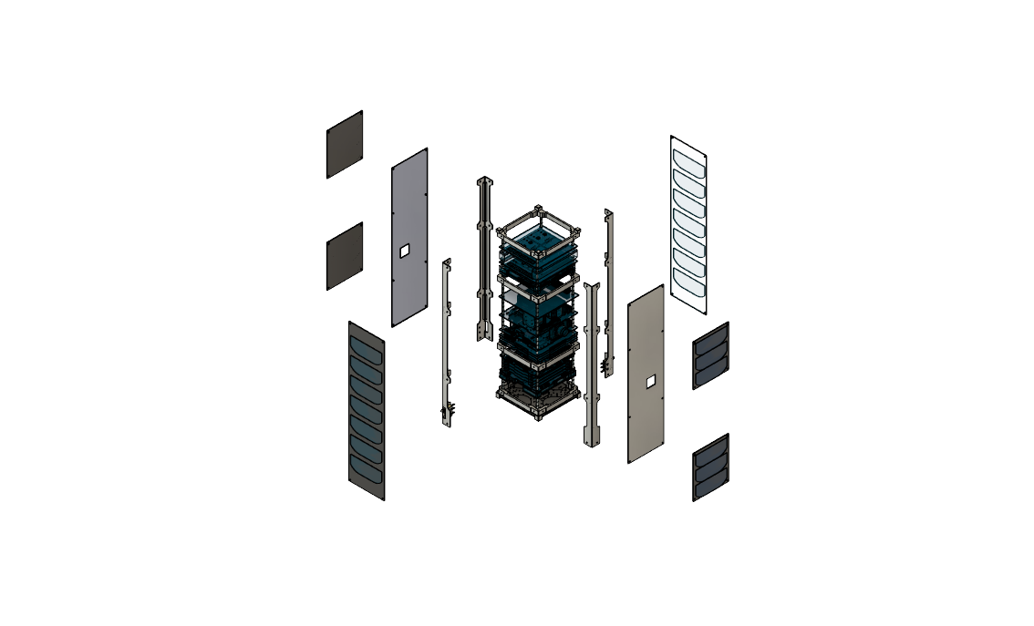
Overview
Project Overview
Design
Simulations
Assembly

Slide 3
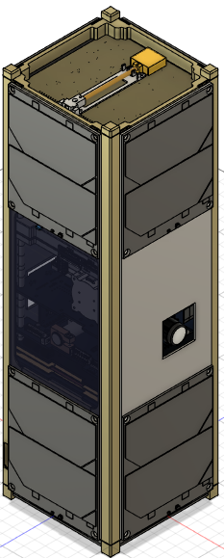
Project Overview
Goal:
  Create a 3U CubeSat structure that can withstand deployment and protect the innerworkings of the satellite

Slide 4
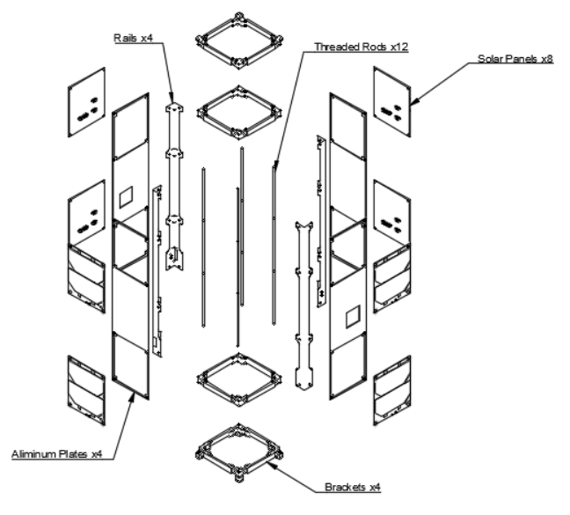
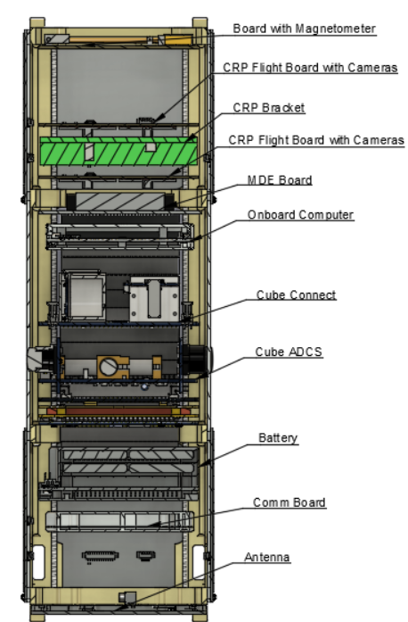
Design

Slide 5
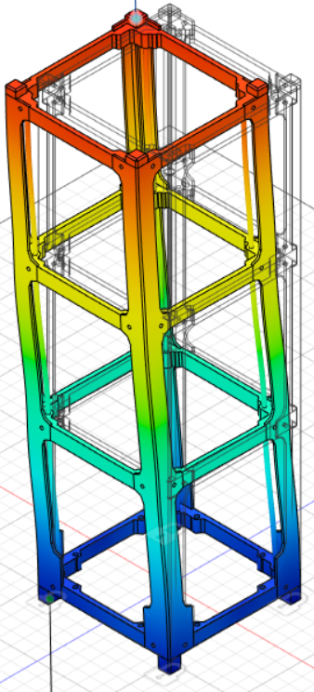
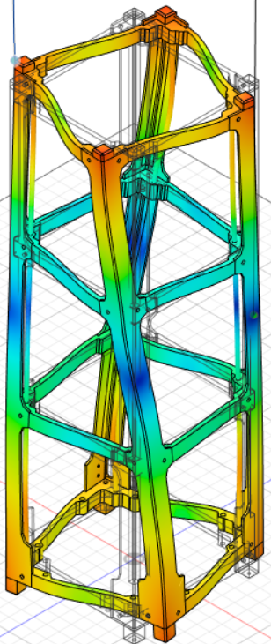
Simulations
Simulations done on Fusion 360
Initial Sims done on just the structure
Simulations Include
  Thermal Tests
  Vibration Tests
  Impact Tests

Slide 6
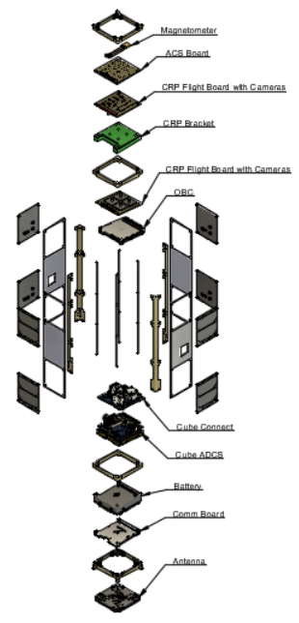
Assembly
Final Assembly will be completed in the Fall of 2022
Launch will be in Spring 2022

Slide 7
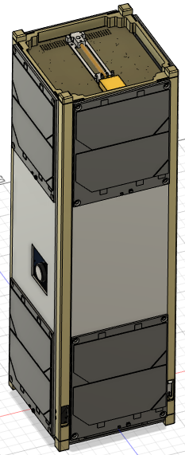
Questions?

